Slide 1
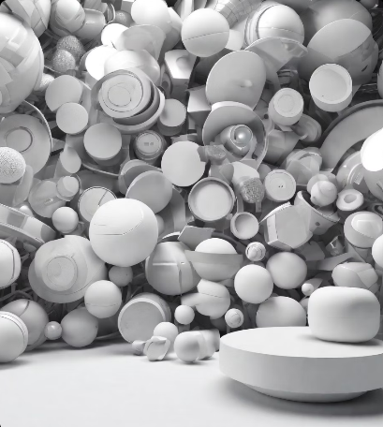
UTM Digital: Empowering the Digital University

Slide 2
UTM Digital Overview
UTM Digital is the Digital University Driver that empowers the delivery of ICT services by adapting the use of the latest technology. Its core function is to develop and implement new applications, upgrade existing applications, and ensure the availability of ICT infrastructure.
Vision: To be a digital university driver. Strengthening academia-centric service delivery through data driven digital ecosystem.
Core function:
- Develop and implement new applications and upgrade existing applications that cover the core business of the University.
- Ensure that ICT infrastructure is always available to support the application platform developed.
- Support the implementation of Digital Lifestyles through development of latest innovation technology.

Slide 3


UTM Digital Services
UTMID
UTMID is a unique identification number given to all students, staff, and faculty at UTM.
Official Email Accounts
UTM provides official email accounts to all students and staff.
UTM Systems
UTM provides various systems for students and staff to access information and resources.
UTM Licensed Software
UTM offers licensed software for students and staff to use.

Slide 4
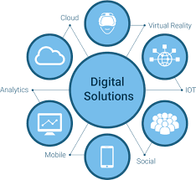
UTM Digital Services
Microsoft 365
UTM provides access to Microsoft 365 for all students and staff.
Network Services
UTM offers network services to ensure reliable and secure connectivity.
ICT Policy
UTM has an ICT policy in place to ensure the responsible and ethical use of technology.
Other Information
UTM provides various other services and resources to support the digital needs of the UTM community.

Slide 5
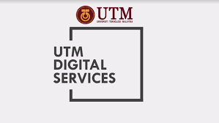
What UTM digital care does ?
Handling issues regarding UTMID and email accounts .
Login and access problems to university systems
Solve Technical problems
Provide software user manual on how to install University licensed software.

Slide 6
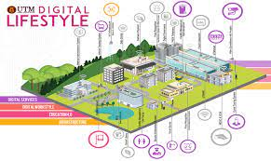
What UTM digital care doesn't do?
1. They don’t install the University licensed software for you.
2. They don’t troubleshoot any problems encountered with UTM licensed software. Users will have to contact the authorized companies to seek help with the problem.
3. They don’t provide hardware, operating system (OS) and software support for personal devices such as computers, laptops or smartphones.

Slide 7
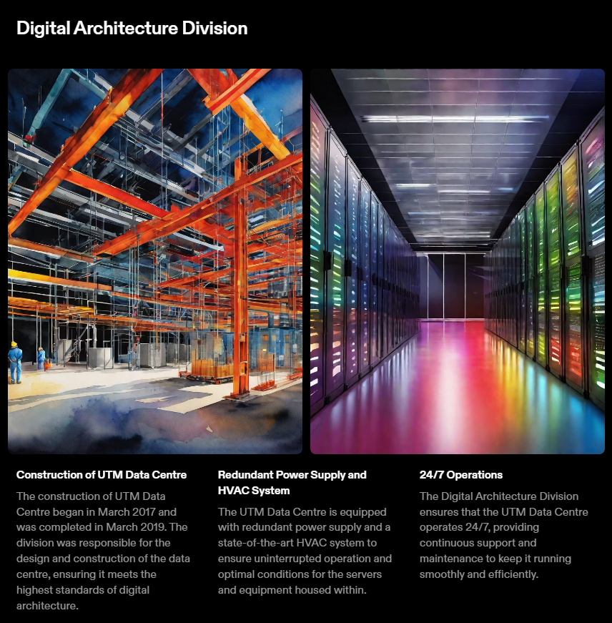

Slide 8
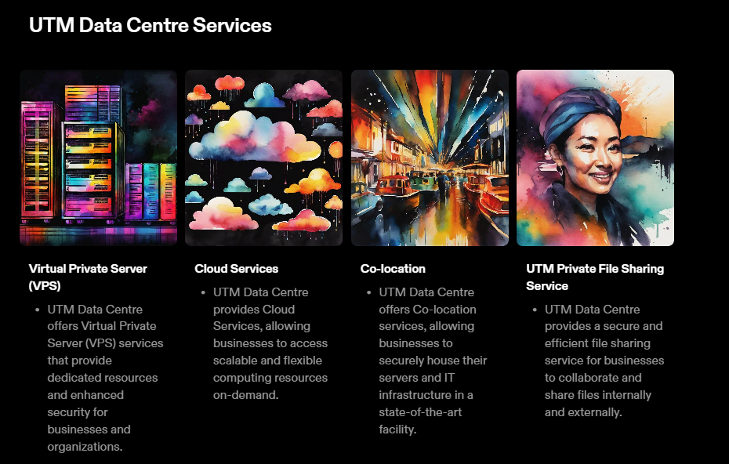

Slide 9
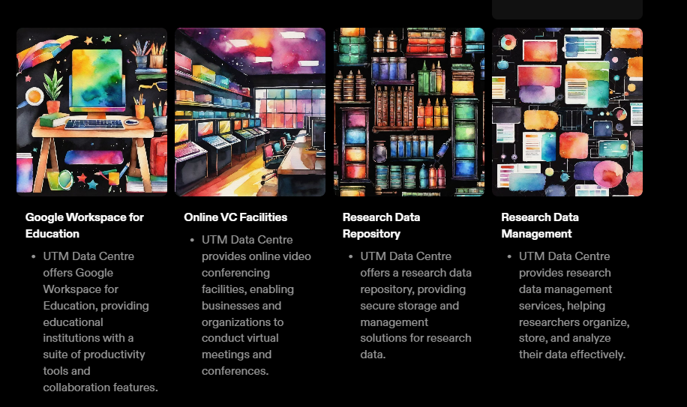

Slide 10
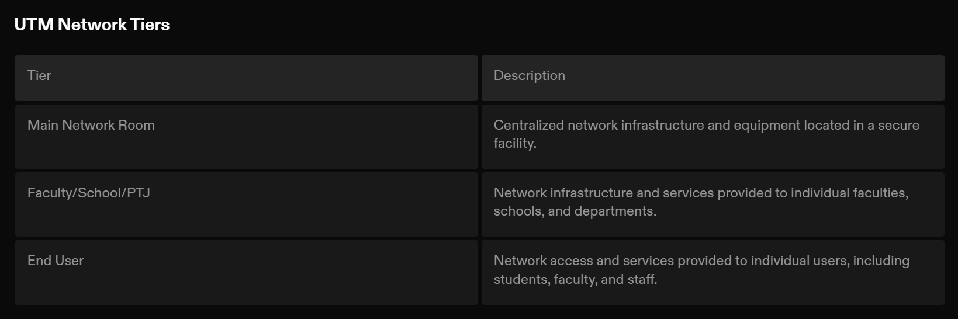

Slide 11
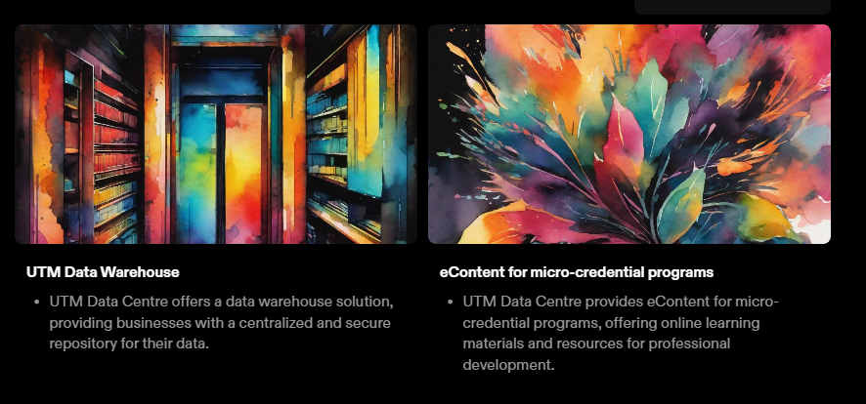

Slide 12
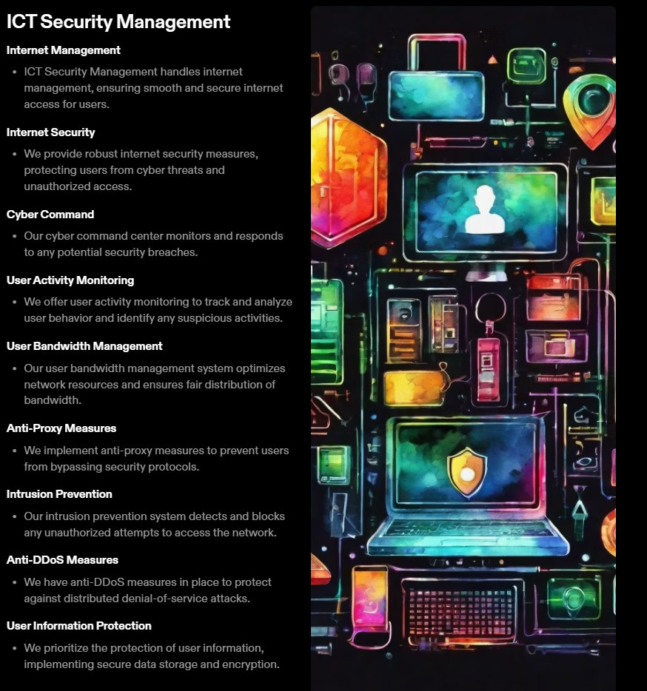

Slide 13
